Slide 1


Slide 2
explore react components in detail
In this section we're going to use some modern JavaScript features

Slide 3
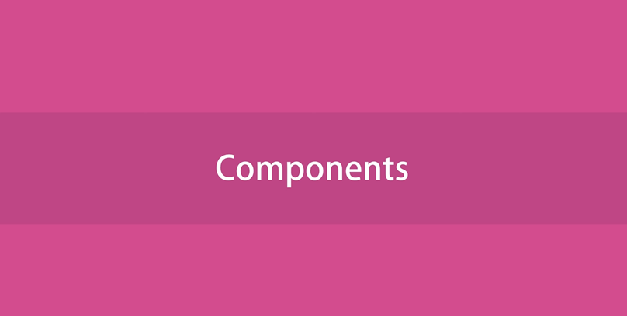

Slide 4
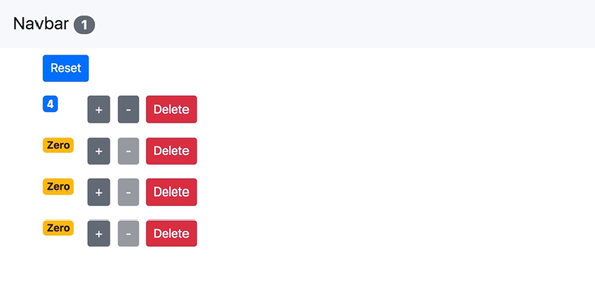

Slide 5
this is actually the pattern behind items in a shopping cart
So imagine each row we have here represents a product
here we have the quantity of that product and the shopping cart we also have buttons to change that quantity
note that if the quantity reaches zero this decrement button becomes disabled

Slide 6
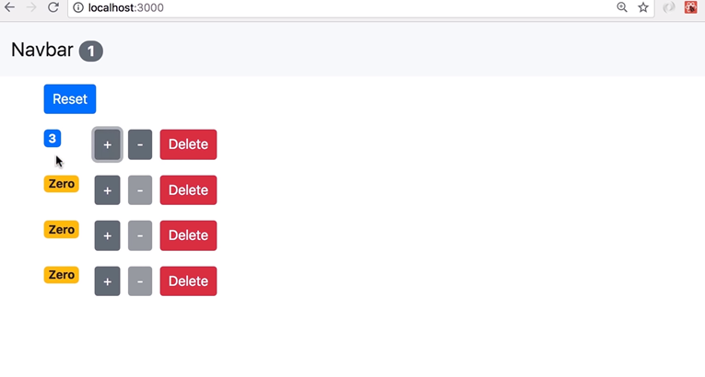

Slide 7
we're displaying the quantity in a yellow badge
so you will learn how to render content dynamically
how to apply CSS classes dynamically

Slide 8
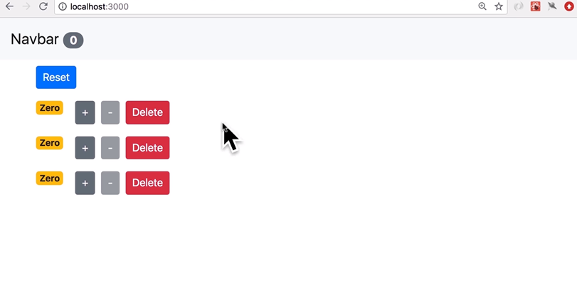

Slide 9
we also have this delete button for removing an item from this list
we also have another button for resetting the quantity of all the items to zero

Slide 10
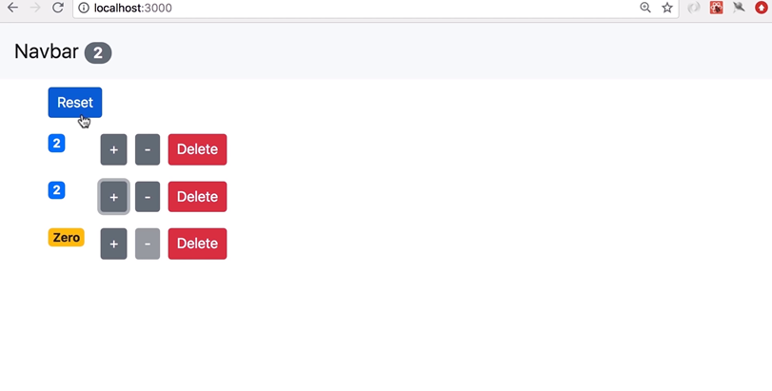

Slide 11
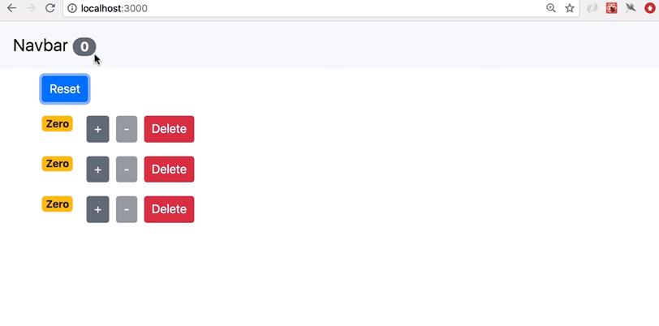

Slide 12
and finally we have badge on the navigation bar which is like e-commerce application so as you add items in the shopping cart it shows the total number of items in the shopping cart
but in this application it behaves a little bit differently it only shows the number of counters with value greater than zero so currently we have
three counters but only the first one its value is 1 and that's why we have one in the navigation bar if I increment the value of the second counter now we have two in the navigation bar so this simple application exhibits patterns that you see in a lot of real-world applications

Slide 13
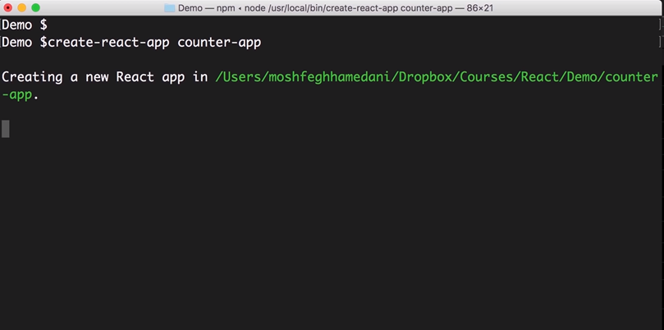

Slide 14
creating a new project from the terminal or command prompt
let's run create-react-app and give our application a name counter–app

Slide 16
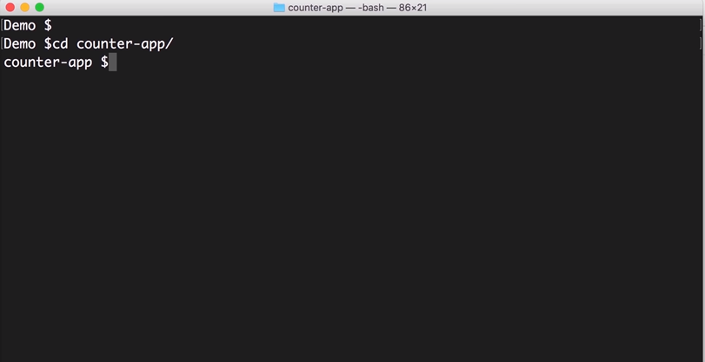

Slide 17
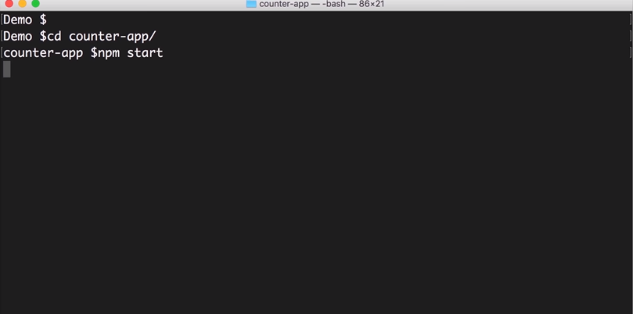

Slide 18
go to this folder counter app
and start the application

Slide 19
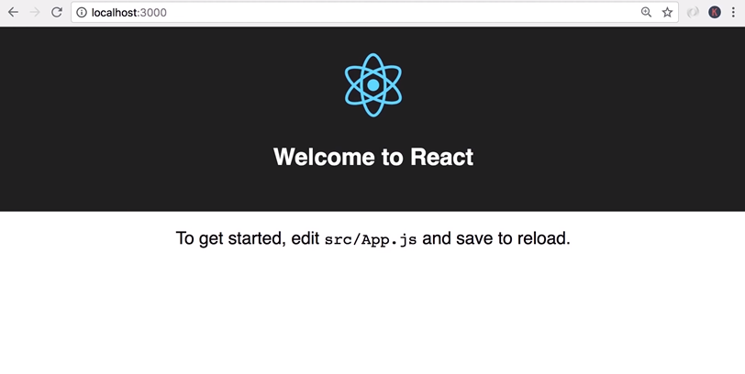

Slide 20
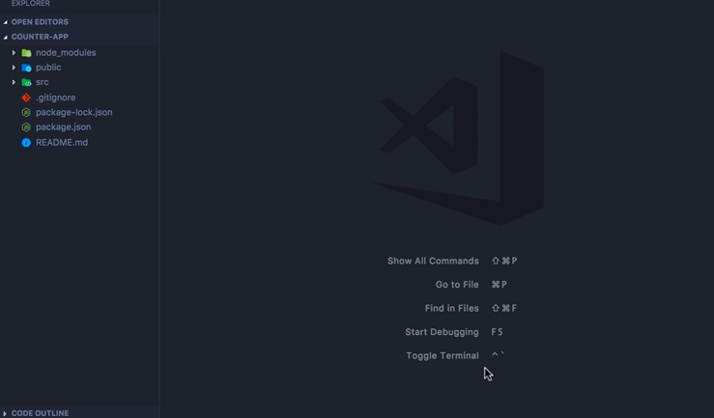

Slide 21
now here in vs code the first thing we need to do is install bootstrap
in case you are not familiar with bootstrap it's basically a CSS library that gives our applications a modern look and feel
To install bootstrap we need to go back in terminal
but if you look here in vs code we have this shortcut toggle terminal on Mac the shortcut is ctrl+ backtick

Slide 22
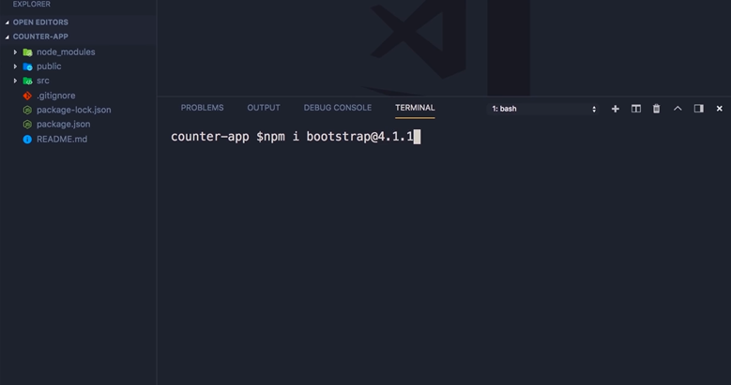

Slide 23
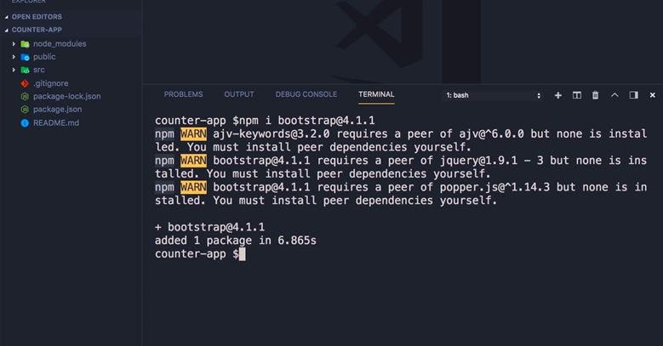

Slide 24
so let's open that up here so here we have an integrated terminal we can run NPM install bootstrap make sure to install the same version I'm gonna install in this video so version 4.1.1

Slide 25
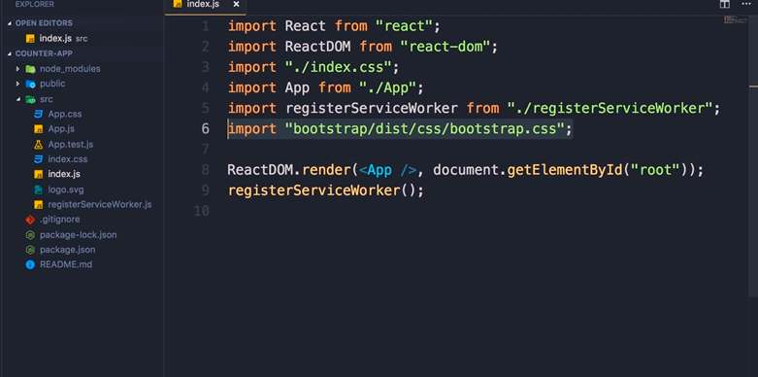

Slide 26
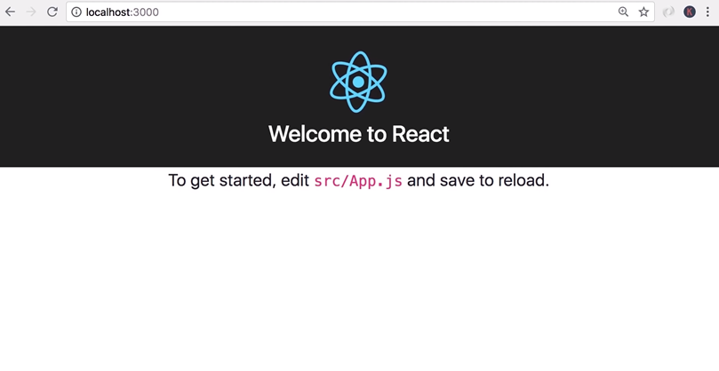

Slide 27
finally we need to import this in index.js
save the changes back in the browser you can see the font is changed

